Slide 1

EMG-Based Predictive Intent Assistance for a Hip Wearable Robot
근전도 기반 운동 의도 예측을 활용한 고관절 웨어러블 로봇 보조 제어
Presenter:Jinwei Liu
Department of Automation
University of Science and Technology of China
Team Name: CoMotion
Team‑Member Name:Yunqi Jin
Hefei,China

Slide 2
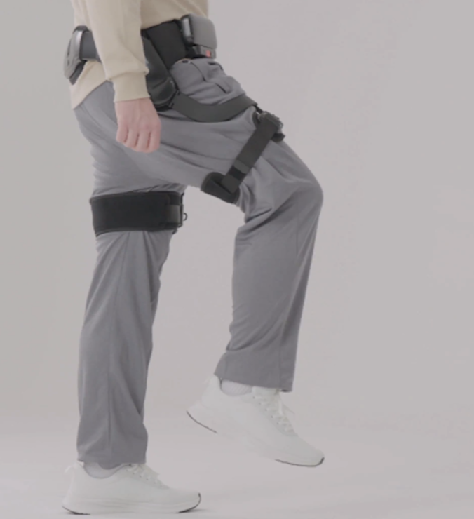
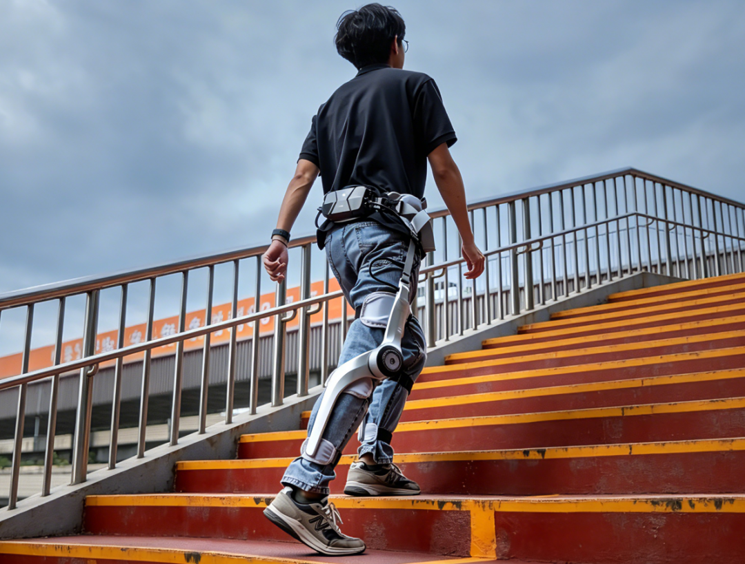
Background
Dynamic human motion intent places higher demands on Wearable Robot assistance.
◆ Time-varying human intent
◆ Assistance–intent mismatch
◆ Safety–performance trade-off
Wearable Robots are transforming movement assistance from fixed support to human-centered interaction

Slide 3
Insight
Assistance Should Follow Human Intent While Preserving Human Control (Sense of Agency)
Predict human intent before motion begins
Provide assistance aligned with the intended movement
Preserve the user’s control over the movement (Sense of Agency)
What is the problem?
What is human motion intent, and how can we predict it?
How should wearable robots deliver assistance according to the predicted intent?
How to preserve the user’s sense of agency over movement?

Slide 4
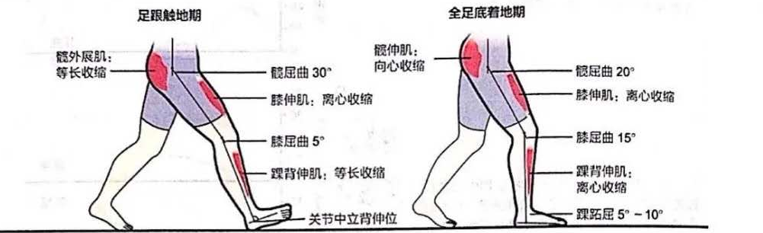
System Overview: Wearable Robot and Sensing Configuration

Slide 5
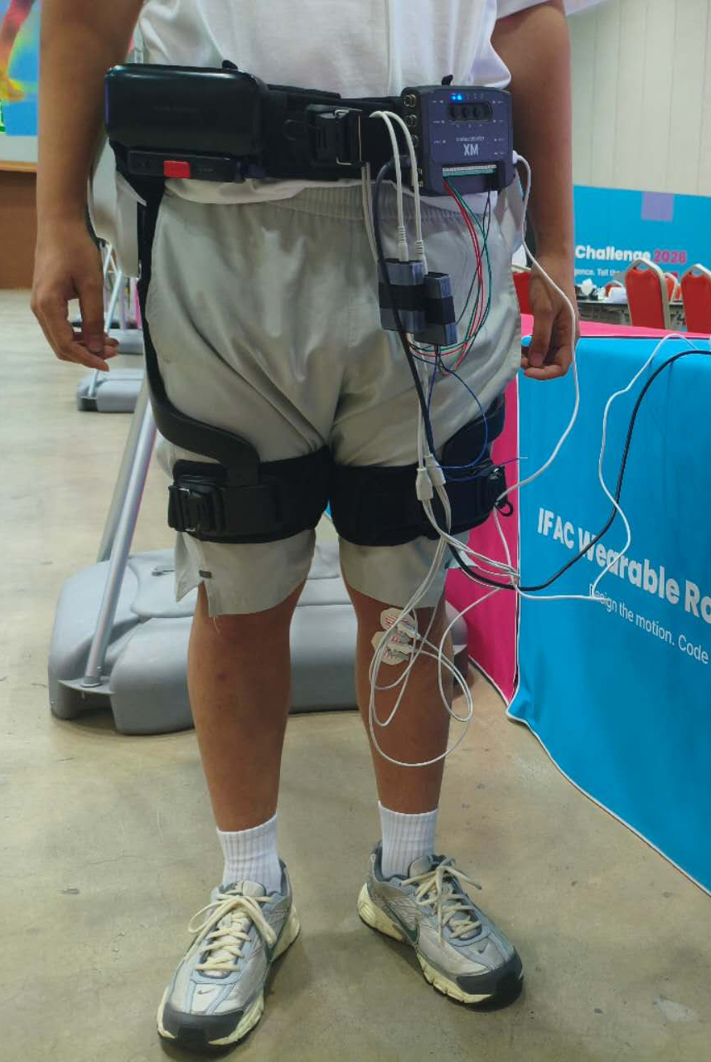
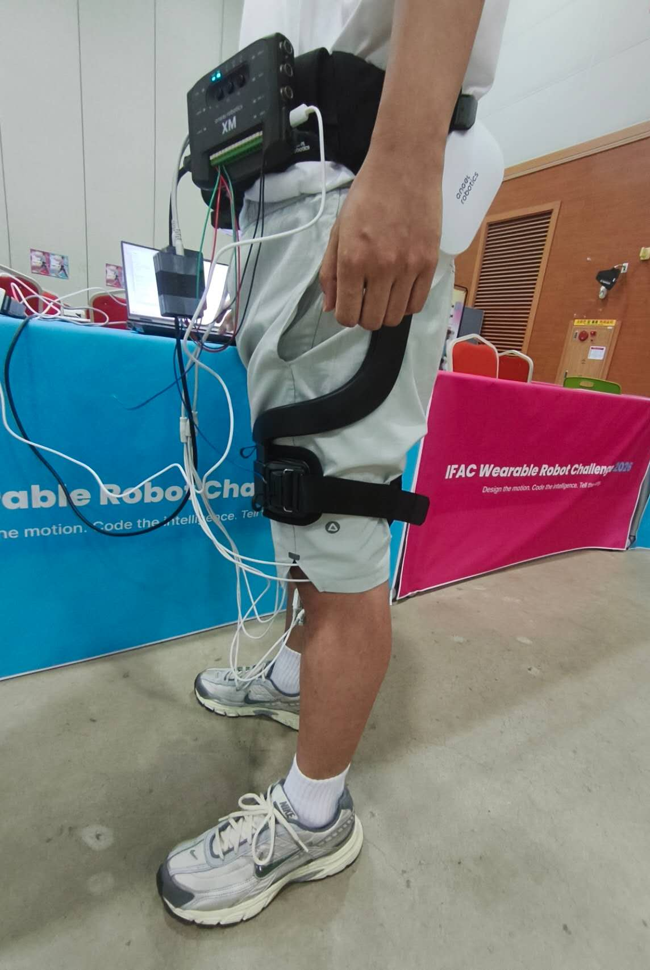
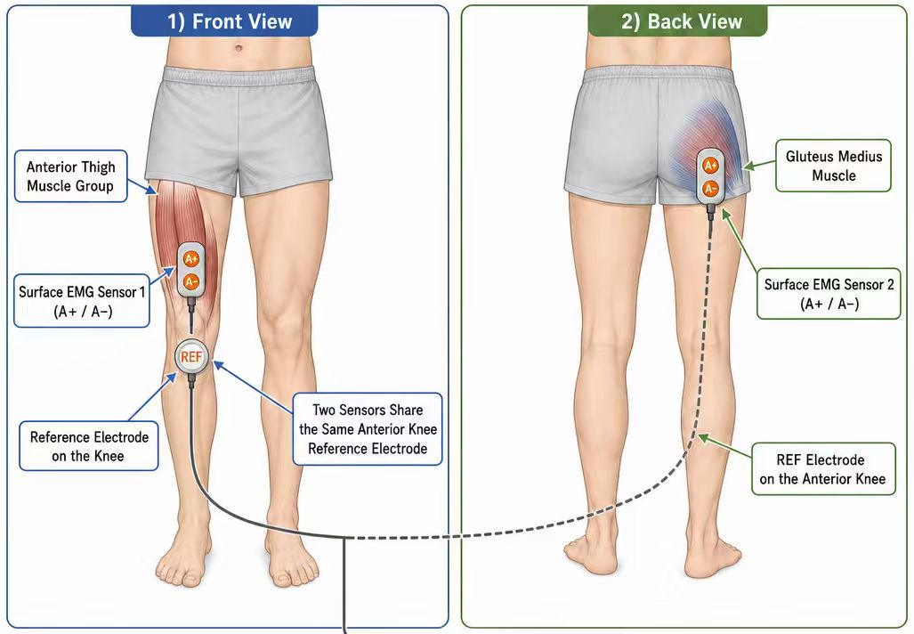
System Overview: Wearable Robot and Sensing Configuration

Slide 6
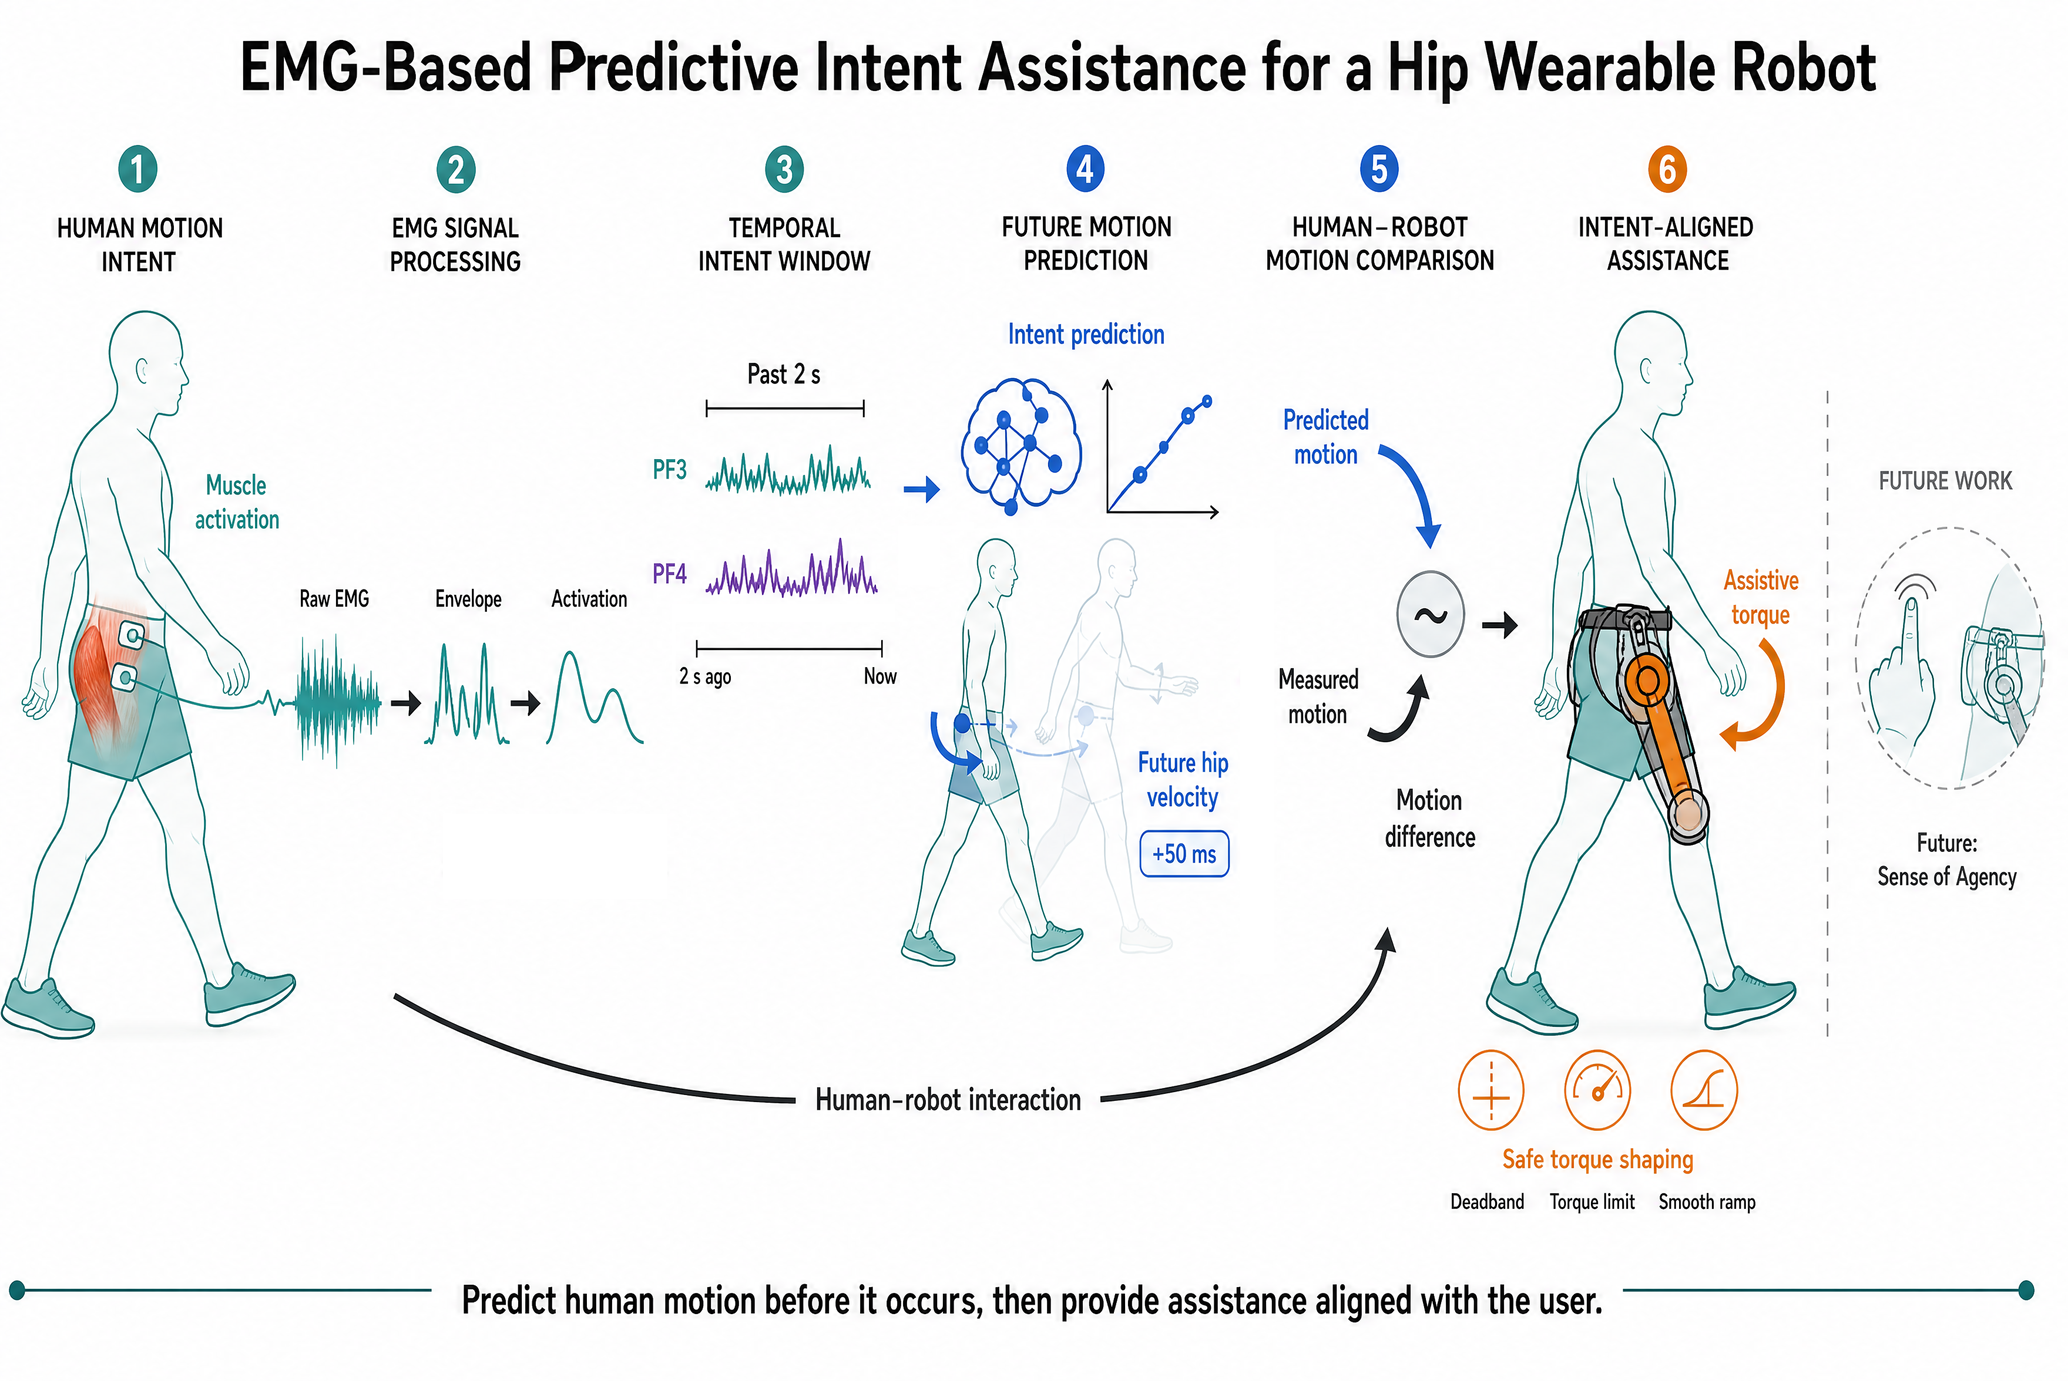
Our Method

Slide 7
Our Method
Intent Predictor
Assistive Torque Controller

Slide 8
Our Method
Intent Predictor
Assistive Torque Controller

Slide 9
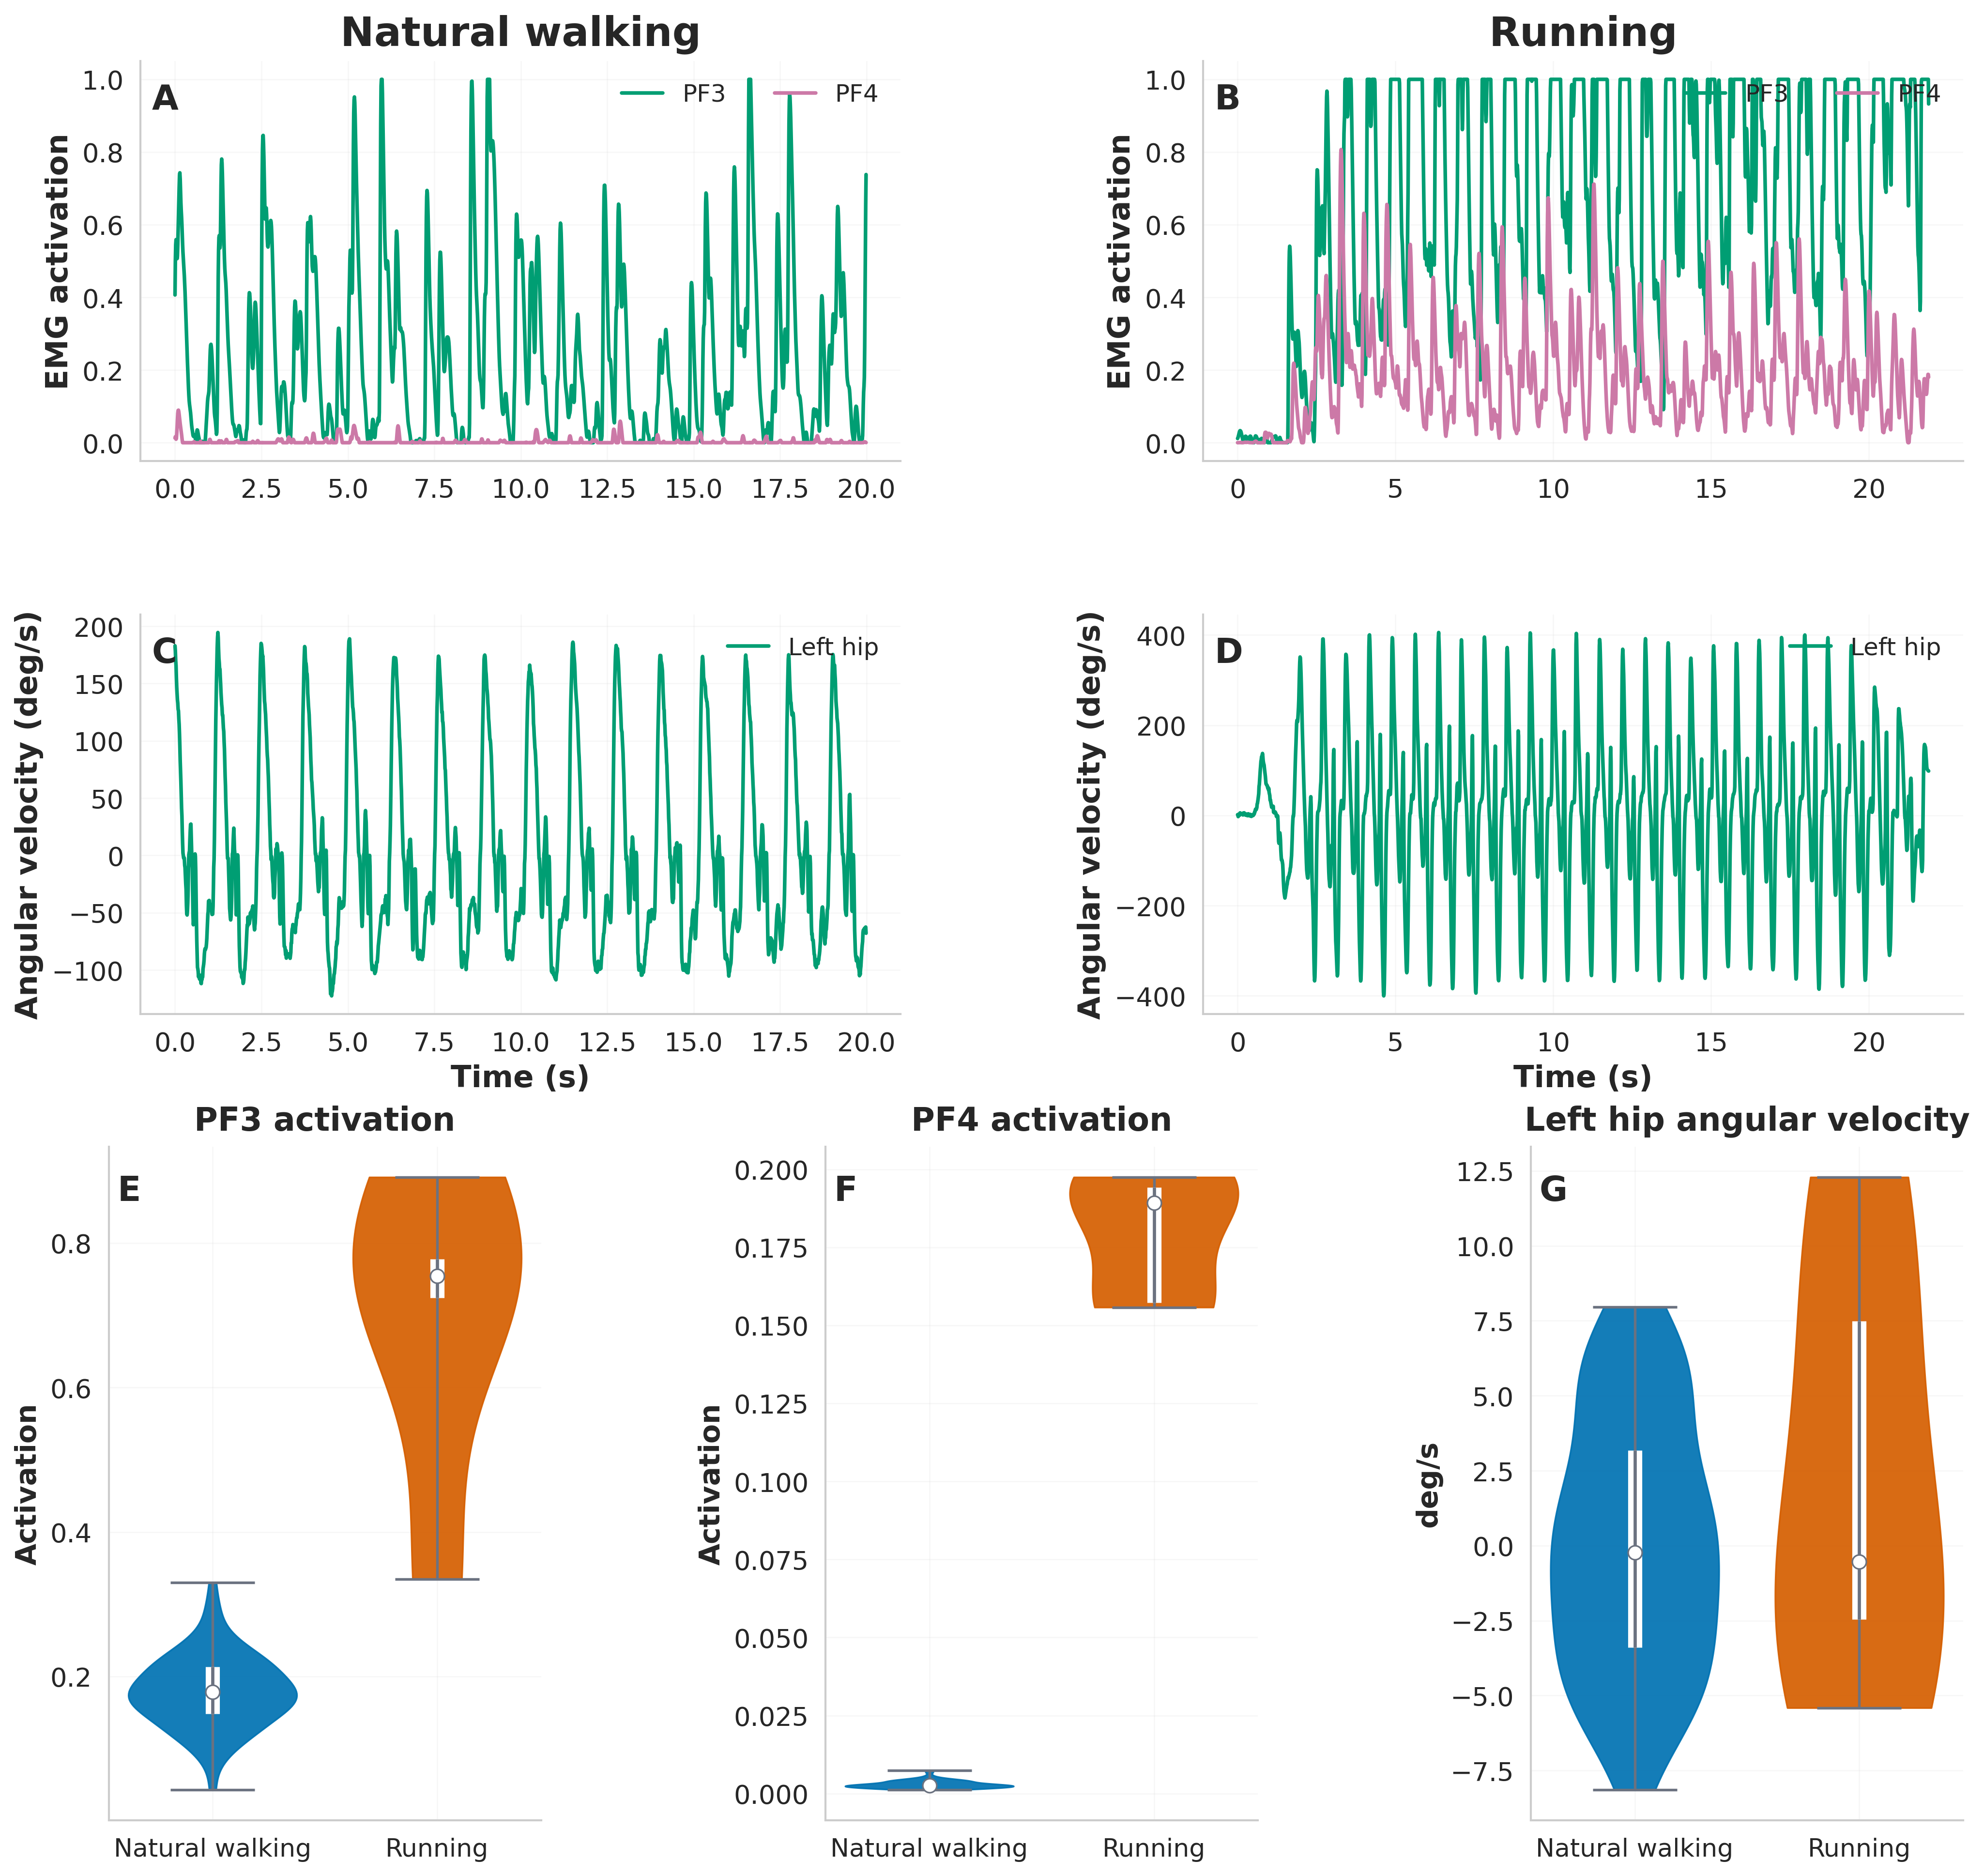
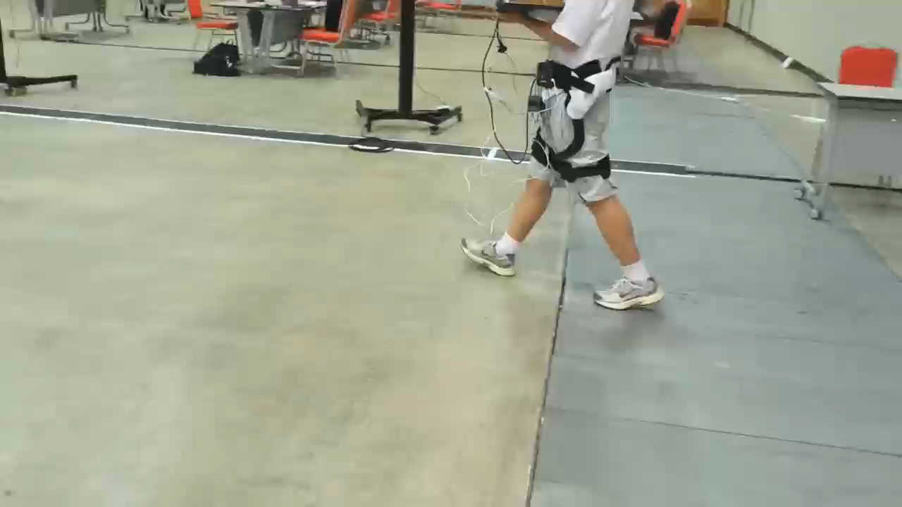

Our Method: Intent Preditor
Natural walking
Running

Slide 10
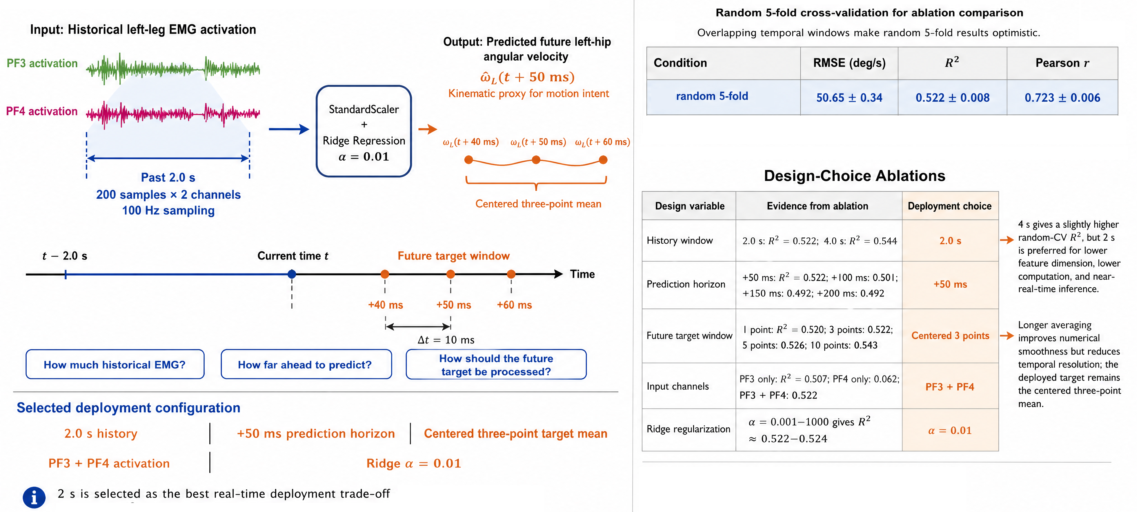
Our Method: Intent Preditor

Slide 11
Our Method
Intent Predictor
Assistive Torque Controller

Slide 12
Our Method: Assistive Torque Controller
Predictive velocity error:$e_{ω}\left(t\right)={\overset{ˆ}{ω}}_{L}\left(t+50 ms\right)−ω_{L}\left(t\right)$
Assistive torque generation:$τ_{L}\left(t\right)=s_{τ} α e_{ω}\left(t\right)$
Safety-aware torque shaping:$τ_{L}^{t}=\operatorname{RateLimit}\left[\operatorname{Sat}\left(s_{τ}αe_{ω}\right)\right]$

Slide 13
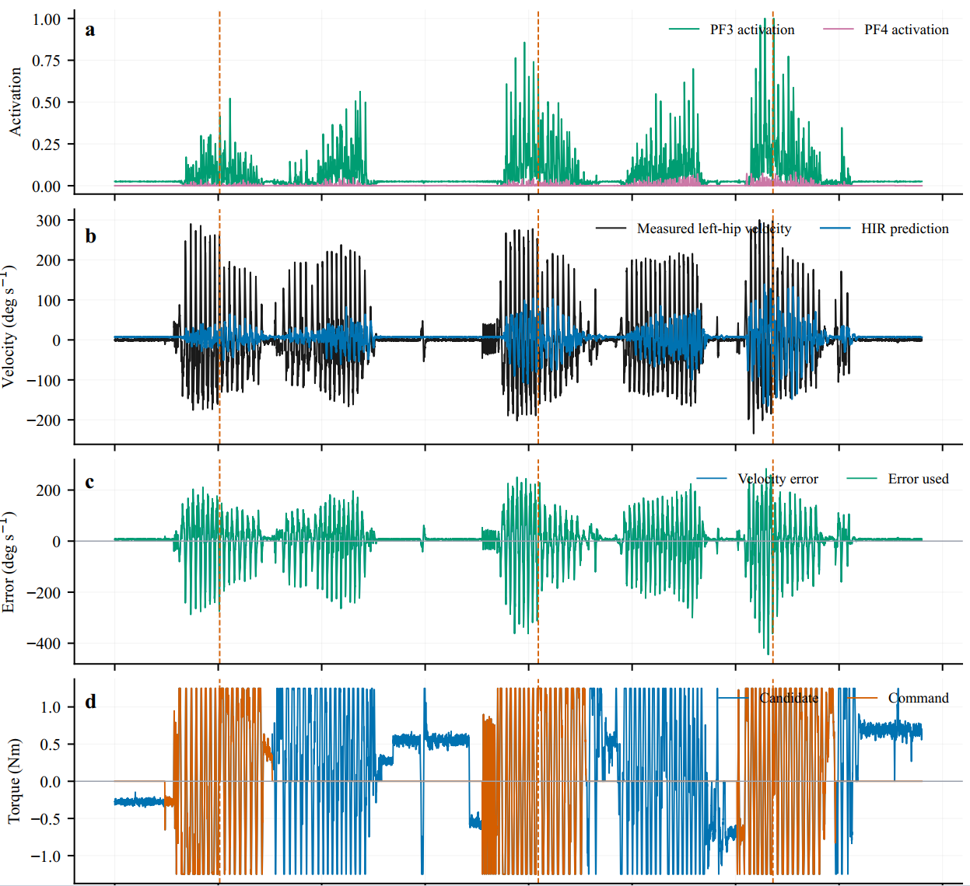
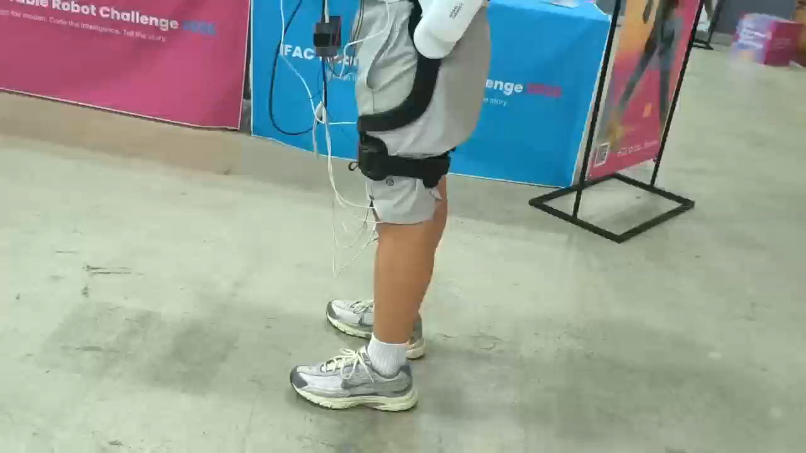
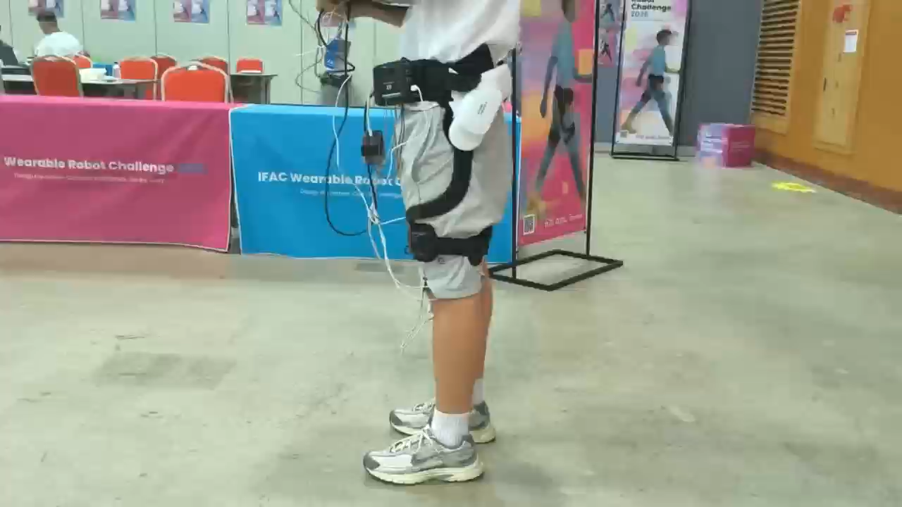
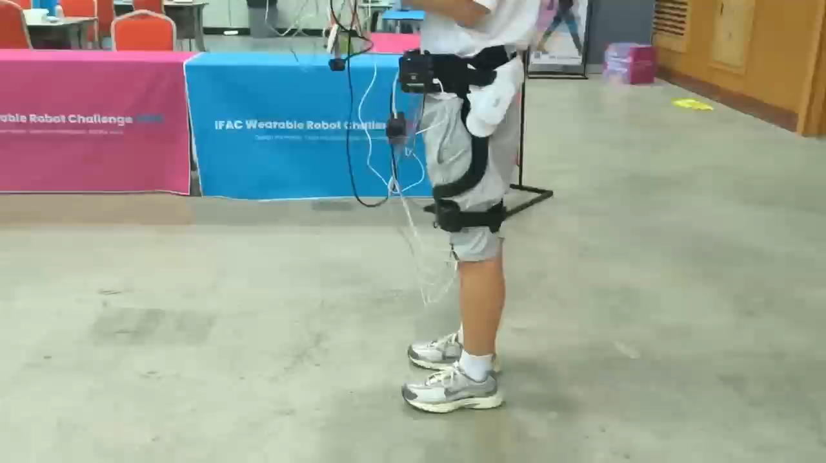
Result
Assist-Resist
Normal
①
②
①
②
③
③

Slide 14
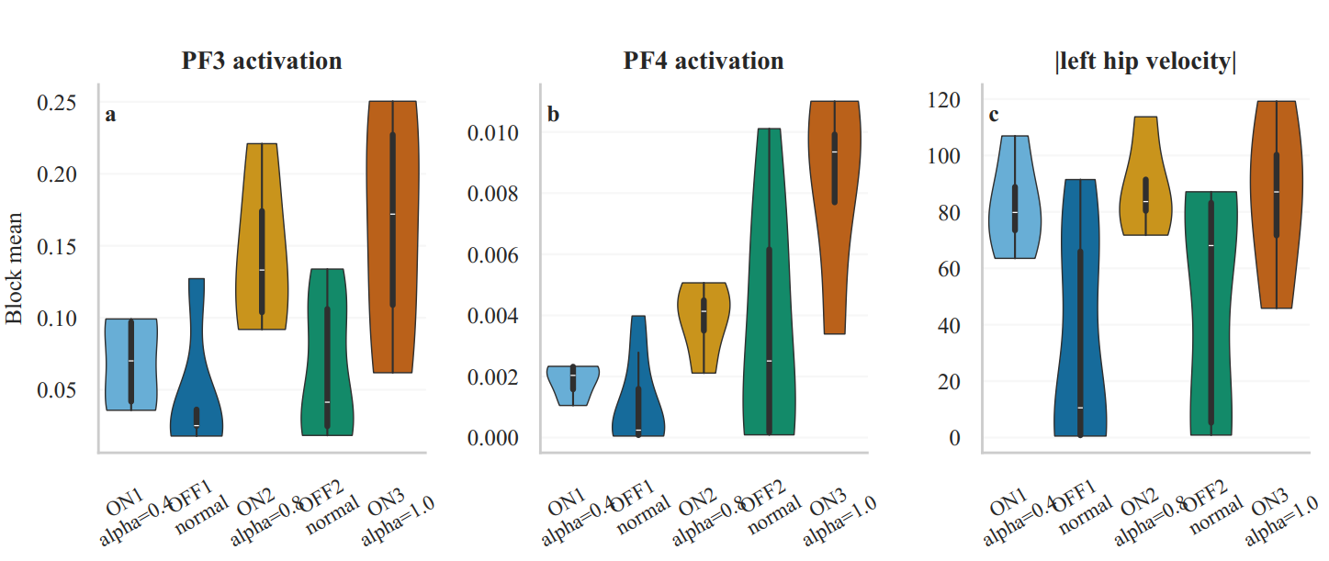
Result
PF3 and PF4 muscle activation was generally higher during robot-active periods than during normal walking.
PF3 and PF4 activation increased across successive robot-active bouts. This trend may be related to individual factors such as adaptation to the wearable robot, changes in walking pace, or accumulated fatigue. However, the assistance level also increased across trials, so the effects of assistance intensity and trial order cannot be separated.
The amplitude of left-hip angular velocity was clearly higher during robot-active periods than during normal walking.

Slide 15
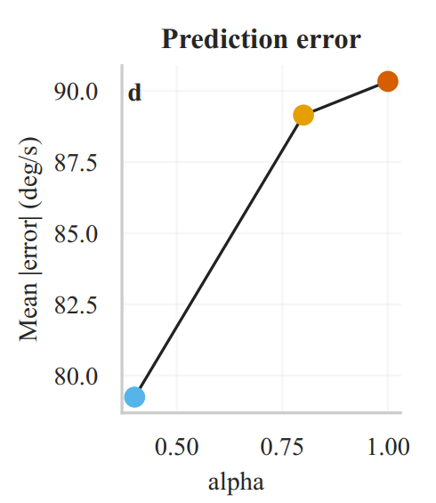
Result
Mean prediction error increased across successive assisted.

Slide 16
Limitations
Single-subject, limited-trial validation
No direct evaluation of effort, comfort, or sense of agency
Future Work
Direct human-centered evaluation of assistance effectiveness and sense of agency

Slide 17
Thanks！

